Slide 1


EVENT PATHWAY STRUCTURE
FREESTYLE CANADA

Slide 2

Competition Pathway
Analysis of each P/TSO competition system/pathway :
- Survey
- Meetings / discussions
- FC analysis through data
Why?
- Decreased participation in Moguls outside Quebec
- Lack of meaningful training/competition opportunities for some athletes
- Slopestyle: venue needs to meet current athlete skill level
- Slopestyle: low women participation (especially at CC level)
- Current Canada Cup events trying too many stages
- There is a cost barrier
- Our environment/realities are changing

Slide 3
Solution
The Canada Cup circuit will now be separated in 2 categories :
Canada Cup - FIS series : Focus on Learn 2 Compete athletes, FIS format, offering transition before NorAms
Philosophy: Perform - “Skill consolidation & learn to perform on-demand”
*(reflects Canada Cup events from last year)
Canada Cup - Development series : Focus on Train 2 Train athletes, “Best of 2” format, and age categories
Philosophy: Development - “Skill acquisition focus & Introduction to competing”
*New layer of events

Slide 4

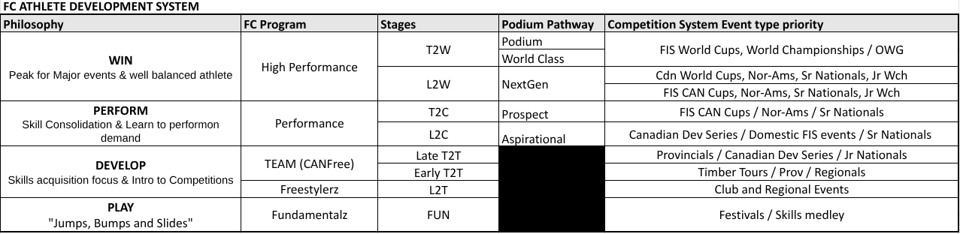
Goals of the new layer
Add a new national layer of events, targeting Train-2-Train athletes
Help our P/TSOs bridge gaps — benefits and goals will be different from one P/TSO to another
Have more National training/competition opportunities for our smaller P/TSOs
Increase mogul participation and retention across the country
Increase women participation and retention in SS (more progressive pathway)
Enable more appropriate terrain for targeted athletes at this change (consequently better course for FIS level SS events)
More local opportunities, compete in your region at a National level: keep costs low for the OC
Ensuring a more progressive athlete pathway
Optimize officials’ development locally

Slide 5
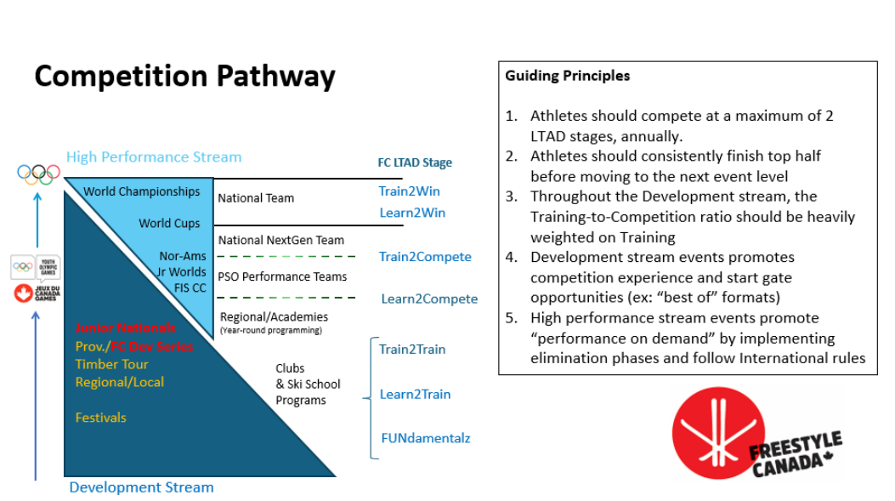
Event structure update

Slide 6
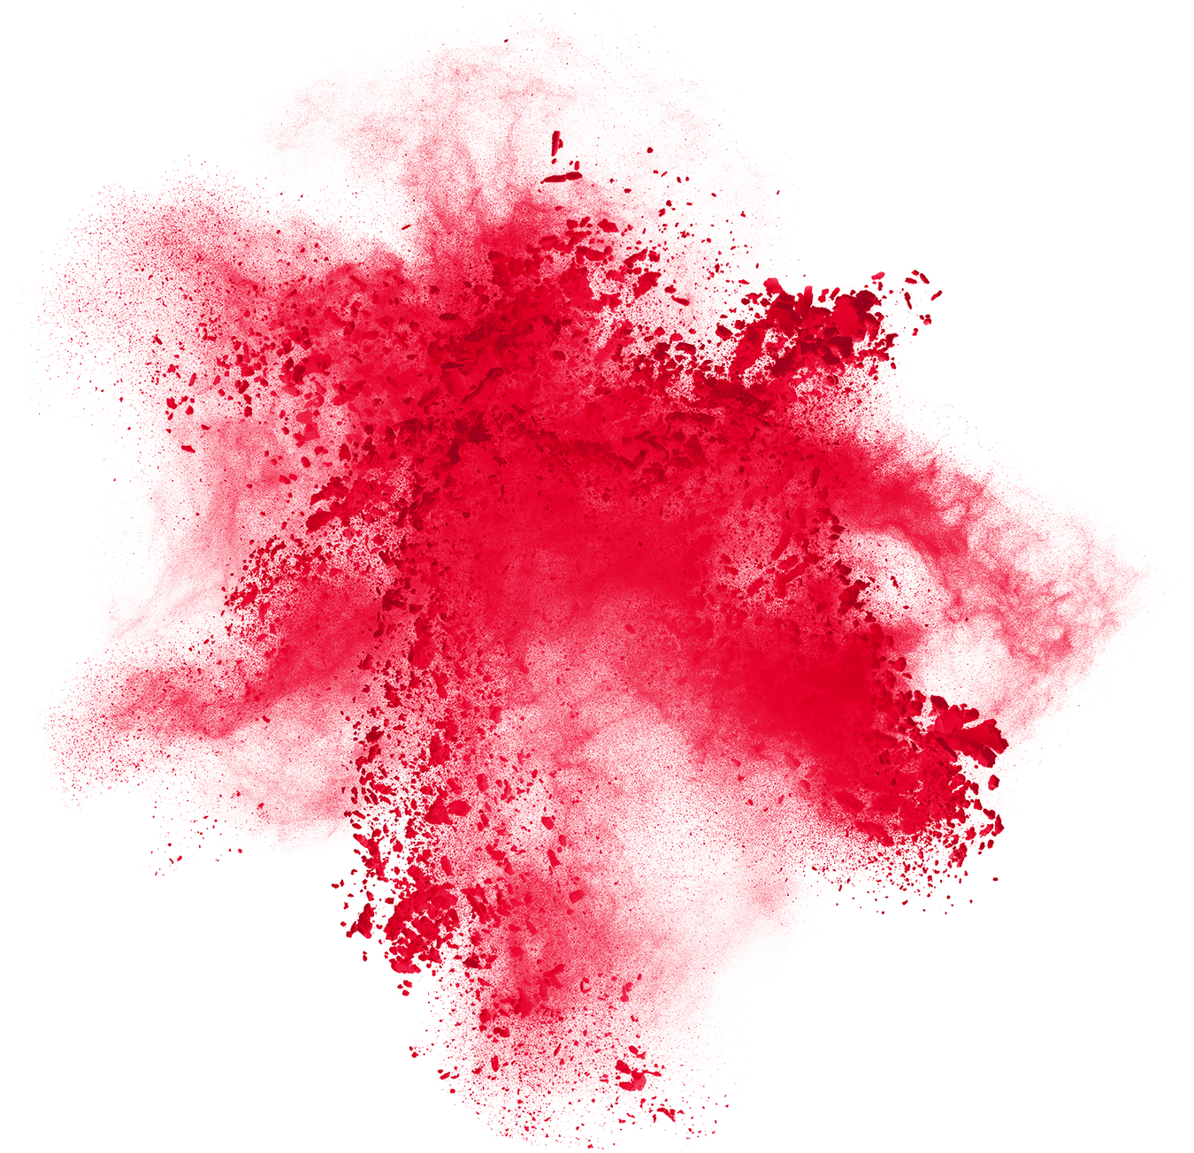
2025-2026 calendar
MO/DM NorAm (CAN)
Apex
VSC
Canada Cup - FIS Series
Apex
Panorama
Senior Nationals (Sommets Saint-Sauveur)
Canada Cup - development series
Canyon
Calabogie
Junior Nationals (Panorama)
SS/BA/HP/RE
NorAm (CAN)
Stoneham
Whistler
Winsport (2x HP)
Canada Cup - FIS series
Sun Peaks
Wentworth
Canada Cup - development series
Horseshoe
Winsport
Junior Nationals (Stoneham)
Notes:
Whistler will be identified as our Senior Nationals - our way to make the event more profitable and more attractive for National Team

Slide 7

Why these formats & guidelines?
Canada Cup - Development series is targeted for Train-to-train level, where the philosophy is to DEVELOP.
Create the best environment for athletes’ skill development and competitive experience; therefore:
Age categories to eliminate some possible barriers, and recognize skill level within age group before advancing to other stages
Best of 2 formats (no finals) : Ensuring 2 runs/jumps for everyone, maximizing practice time and “start gate” mileage. Ensure optimal on snow time.
Officials and coaches are also at a development stage : offer proper environment for them as well

Slide 8
General guidelines for DEV series
Age categories U14 / U16 / U18+ : based on JAN 1st 2026
FC provincial license, registered in a FC club
Field : max of 70 by gender, max field 90 athletes
Spot allocation system :
Base quota spots protected for each P/TSO participating
Round robin re-allocation based on athlete membership ratios
Number of spots all confirmed by November 15th
Athlete list confirmed 1 month before the event
Open registration 1 month before event (after registration deadline)
Officials/judges selection collaboration between host P/TSO and FC (ideally, 1 official from outside P/TSO)
No MSL required, coach and P/TSO responsibility to make sure athletes are ready to compete at this level

Slide 9
Slopestyle - DEV series
SS
Seeding by mixing age categories - results by categories and overall - medals by categories only
Will reward specific skill by gender also (ex: best rail)
3 heats total
Best of 2 runs/jumps
Day 2 : RE, BA, HP or SS
#judges 3 + 1 HJ

Slide 10
Moguls - DEV series
MO
Random start order by gender
Scores by category and overall, medals by categories only
Will reward specific skill by gender also (ex: best turns)
Best of 2 runs (no finals to maximize training)
MO/DM, duals moguls start brackets by categories best of each face off in overall bracket
5-7 judges + 1 HJ

Slide 11
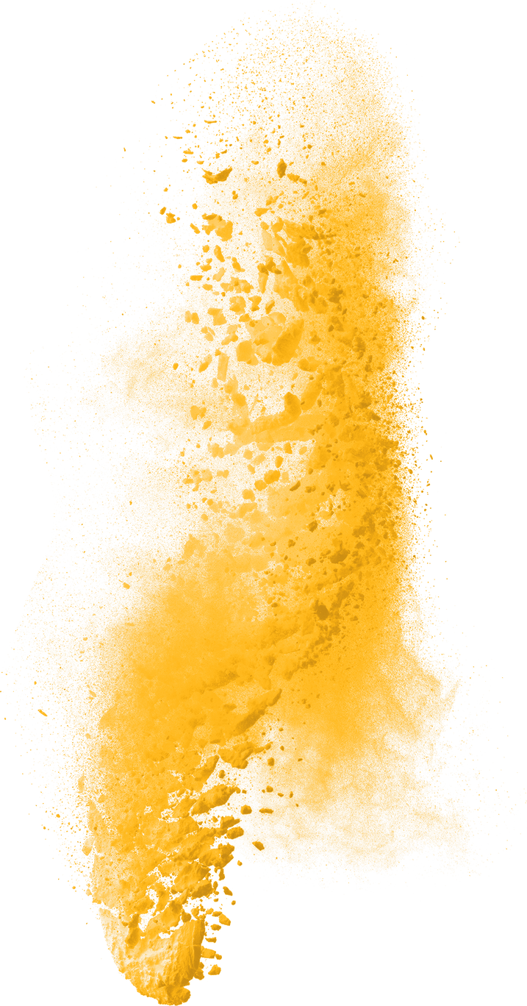
Why these formats & guidelines?
Canada Cup - FIS series targets Learn-to-compete level, where the goal is to learn to PERFORM. Creating the best environment to foster athletes’ performance on demand development by:
using FIS NorAm/JR Worlds formats, to prepare the next generation of athletes
Elimination phases and Finals take importance to learn to perform on demand and learn to make tactical decisions when competing at multi phase events
The goal here is not to maximize start gate experience for all athletes, but introduce elimination phases and prepare them for a high performance context.

Slide 12
Canada Cup - FIS series
General guidelines
FIS for MO and SS
Field size : 90 CDN spots + 10-20 spots reserved for foreign (4 weeks for confirmation and can be released for CAN)
Formats : like in NorAms, SS on 2 days, RE allowed
Spots based on rankings, selection by FC
Eligibility : responsibility from P/TSOs, clubs and coaches to find the right layer of events for athletes to compete in
Notes:
makes sense

Slide 13
Who should participate at DEV series?
Category 1 : Athletes finishing in top half of their provincial circuit ready to compete on a national level with a deeper field and more challenging course
Competitive athletes who train year round (academy, sport-étude, regional team, P/TSO dev team, etc.)
Category 2 : Athletes who require more competing and training opportunities of this level
Club athletes or full year program club athletes
Athletes returning from injury
Philosophy : Develop
LTAD stage : Train to train

Slide 14
Who should participate at FIS series?
Category 1 : Athletes doing full tour
P/TSO team athletes aiming for a spot on National Team and prepare for NorAm circuit.
Athletes part of a year round program who perform consistently in top third of DEV series or their provincial tour. Ready to compete in FIS format consistently.
Category 2 : Athletes doing 1 event for experience
Year round program athletes performing in top half of DEV series or their provincial tour. Ready to take a step up in the system towards more challenging courses and more skilled field. Ready for a FIS format, no age categories and elimination phases.
Philosophy : Perform
LTAD stage : Learn to compete / Train to compete
Philosophy : Develop
LTAD stage : Late Train to Train

Slide 15
Who should participate at NorAms?
Category 1 : Athletes doing full tour
P/TSO team athletes aiming for a spot on National Team, wanting to perform on the whole circuit.
Category 2 : Athletes doing domestic NAC events only
P/TSO team athletes, already competing at all CC FIS events who are ready to gain experience on the NorAm circuit.
Philosophy : Perform
LTAD stage : Train to compete
Philosophy : Perform
LTAD stage : Learn to compete

Slide 16
How to plan competition calendar?
Your best resource is your coach! Consult him/her and your P/TSO for more guidance. Plans will vary according to athlete’S objectives
Examples for competition plans per LTAD stage
Late Train 2 Train athletes (U16+)
1 or 2 provincial event + 1 provincial championship
1 or 2 Canada Cup - Development series events
1 Canadian Junior Championship
1 Canada Cup/FIS event (in his/her region if judged appropriate)
Target : 3 - 6 events
Learn 2 compete athletes
1 provincial championship
1 Canada Cup - Development series events
Canadian Junior Championship
2 or 4 Canada Cups/FIS events
1 or 2 domestic NorAm
Target : 5 - 8 events
Train 2 compete athletes
Provincial Championship
Canada Cup - FIS series
Senior National Championship
NorAm tour
Target : 6 to 10 events

Slide 17
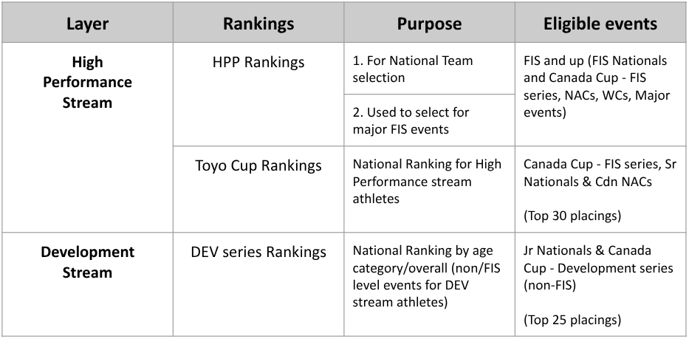
RANKINGS
For more information about rankings please consult FC’s ranking policy.
*The DEV series rankings will only be used as a tool for P/TSOs for their own rankings and for athletes to compare themselves on a National scale. DEV series rankings will not be used for selection of any event in 25-26 or 26-27.

